Slide 1
Core Java – Class 7

Slide 2
Topics
Maps
HashMap, Hashtable, TreeMap
Threads

Slide 3
Maps
Map is a data structure (a type of Collection) to store/retrieve keys/values. This is like a dictionary
All the methods that are supposed to be implemented by a Map are defined in an interface named Map
Java provides different types of Map implementations
HashMap, HashTable, TreeMap, ConcurrentHashMap
Accessing elements defined in one of the above implementations is pretty fast. Java uses a concept of hashing and storing the elements in a bucket for faster retrieval
Accessing elements in the Array or a Collection is sequential and becomes slower when the size of array becomes longer where as time to access the elements in the Map is same irrespective of the number of elements in the Map.
The reason for faster access is, the lookup is done exactly on the bucket where an element is placed
Java (HashMap) uses object.hashCode() and runs a hash algorithm on this number to find the bucket where an element needs to be place

Slide 4
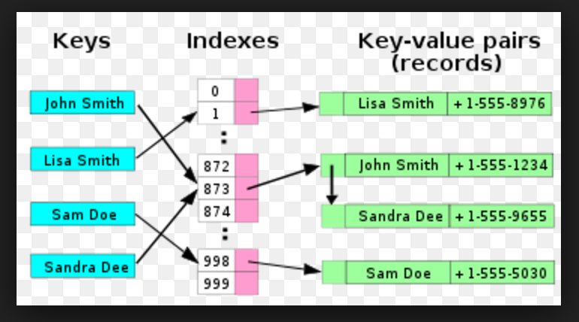
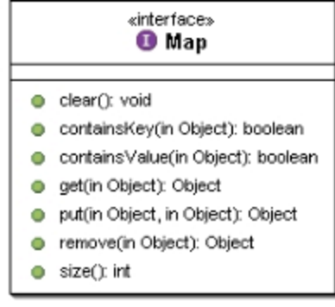
Map contd..

Slide 5
Threads
Performing operations concurrently (in parallel)
We can walk, talk, breathe, see, hear, smell... all at the same time
Computers can do this as well - download a file, print a file, receive email, run the clock, more or less in parallel….
How are these tasks typically accomplished?
Operating systems support processes
What’s the difference between a process and a thread?
Processes have their own memory space, threads share memory
Hence processes are “heavyweight” while threads are “lightweight”
Most programming languages do not allow concurrency
Usually limited to operating system "primitives" available to systems programmers
Java supports concurrency as part of language and libraries

Slide 6
An Overview of the Thread Methods
Thread-related methods
See API for more details (especially exceptions)
Constructors
Thread() - Creates a thread with an auto-numbered name of format Thread-1, Thread-2...
Thread( threadName ) - Creates a thread with name
run
Does “work” of a thread – What does this mean?
Can be overridden in subclass of Thread or in Runnable object (more on interface Runnable elsewhere)
start
Launches thread, then returns to caller
Calls run
Error to call start twice for same thread

Slide 7
Thread States: Life Cycle of a Thread
Born state
Thread just created
When start called, enters ready state
Ready state (runnable state)
Highest-priority ready thread enters running state
Running state
System assigns processor to thread (thread begins executing)
When run completes or terminates, enters dead state
Dead state
Thread marked to be removed by system
Entered when run terminates or throws uncaught exception

Slide 8
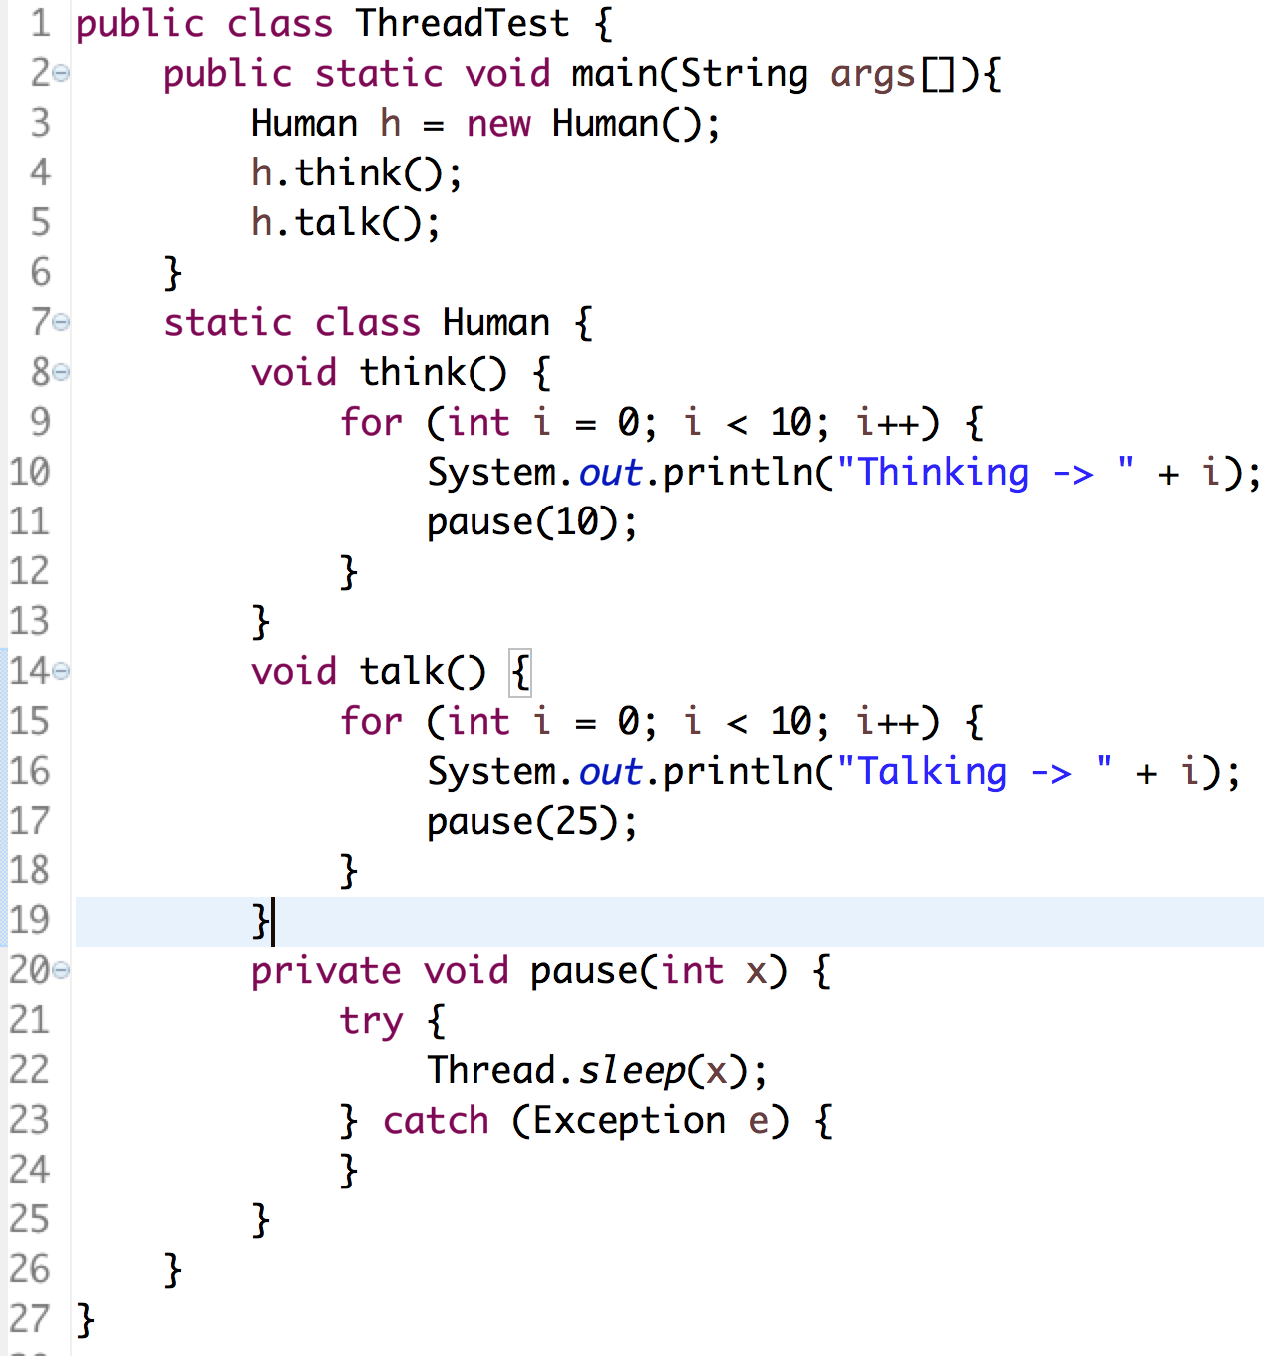
Java Program – without Thread

Slide 9
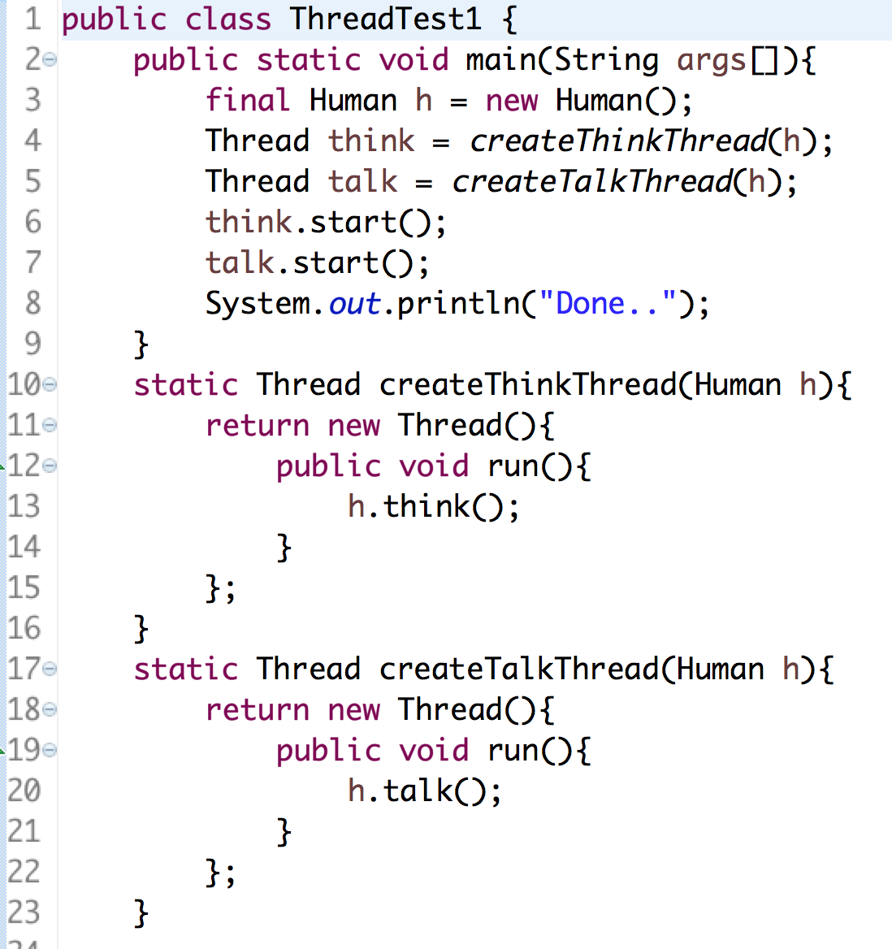
Java Program – with Threads

Slide 10
Thread Synchronization
Synchronization is a mechanism to control the flow of code when different threads are executing
Monitors
Object with synchronized methods
Any object can be a monitor
Methods declared synchronized
public synchronized int myMethod( int x )
Only one thread can execute a synchronized method at a time
Obtaining the lock and locking an object
If multiple synchronized methods, only one may be active
Java also has synchronized blocks of code

Slide 11
Java Code - Synchronized

Slide 12
Runnable Interface
Java does not support multiple inheritance
Instead, use interfaces
Until now, we inherited from class Thread, overrode run
Multithreading for an already derived class
Implement interface Runnable (java.lang)
New class objects "are" Runnable objects
Override run method
Controls thread, just as deriving from Thread class
In fact, class Thread implements interface Runnable
Create new threads using Thread constructors
Thread( runnableObject )
Thread( runnableObject, threadName )

Slide 13
Wait and Notify
Waiting and Notification is a mechanism to pause and resume execution of Threads
This is needed for intra thread communication
For eg:- A professor asks a question to the students. He needs to wait till the Student responds and then professor can say whether the answer is right or wrong
Professor Thread is executing – Student thread has to wait
Professor Thread has to wait after asking a Question – Student Thread gets notified and answers the question
Professor gets notified after Student answers the question – Student Thread has to wait to hear the feedback from professor etc.

